Slide 1
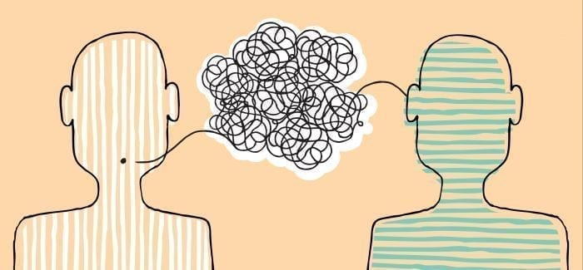
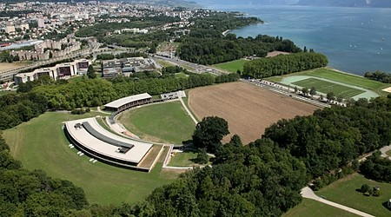
Communicating as a University Professor with Aphasia
Jürg Schwyter (Switzerland)
Notes:
Today, I’m going to tell you, how aphasia changed my life as a university professor.
But first of all…

Slide 2
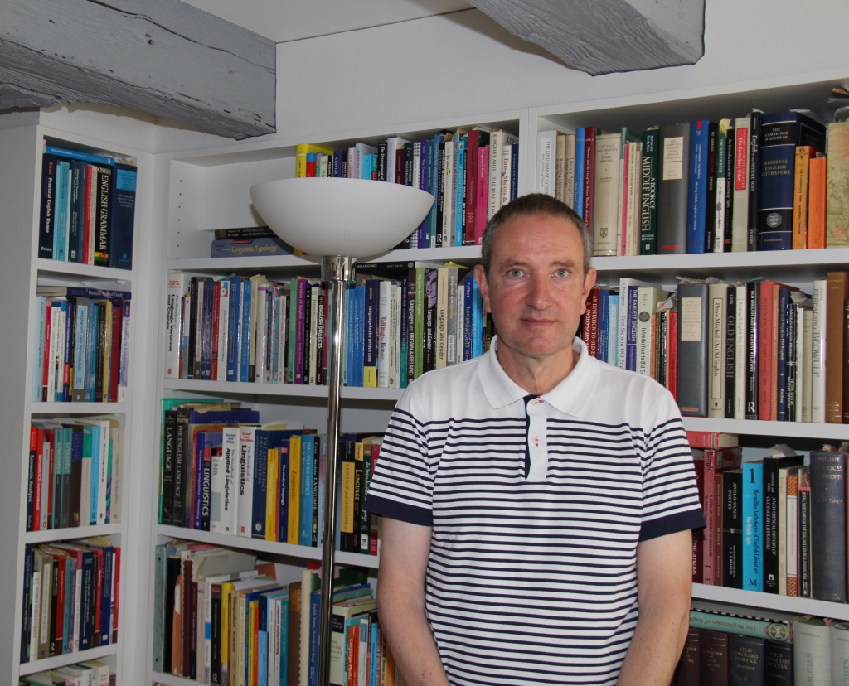
1. Me and my Stroke
Notes:
…I’d like to begin by saying a few words about myself, and the stoke which I suffered 13 years ago.

Slide 3
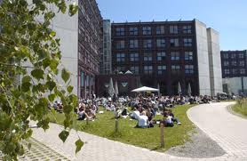
Who am I?
I used to be Professor of English Linguistics and Head of the University of Lausanne’s English Department when, in 2009, I suffered a severe brain stroke. Having retired from my post in 2020, not least because of Covid-19, I am now a research fellow at the Department.
Notes:
By the way, this PowerPoint presentation has a special format, i.e. all is written down, and after today’s presentation, you will understand why!

Slide 4
What happened to me
It was Friday, 20 February 2009, and I had a severe cold. I was at home and I decided to call the secretary of the English Department to say that I wouldn’t be coming in today. “No problem”, the secretary said, he would do the necessary (i.e. cancel appointments, put up notices on doors that I would not attend classes today, etc). I felt reassured and I went into the kitchen and made myself a cup of tea.
Then I wrote the most important e-mails (curiously, I know exactly which e-mail I wanted to reply to) and then it just hit me like a “blow to the head”, I fell off the chair, onto the right side of my body, and then onto the floor. Over and over again, I asked myself what the matter was – I couldn’t move one little bit; I was paralysed and, I later realised, I could not talk…

Slide 5
My partner was on a business trip, so it was my good luck that my sister knew I was alone and not very well, and she tried to reach me by telephone. The first 2-3 times she wasn’t unduly worried and just spoke to the answering machine, but the next morning things changed: she telephoned a neighbour and the concierge, all of whom of course didn’t get an answer from me either, and my sister finally called the police.
The Lausanne police, of course, tried to talk her out of breaking into my flat and came up with all sorts of excuses (“The weather is so nice, Mr Schwyter went skiing perhaps”, etc).
But my sister was adamant and she said I was so reliable and she would have known about it.

Slide 6
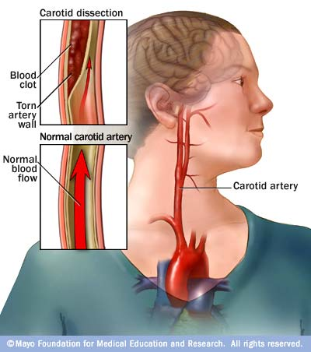
So my sister had the door broken down – and there I was on the floor:
it was ca. 36 hours after I had suffered the stroke!

Slide 7
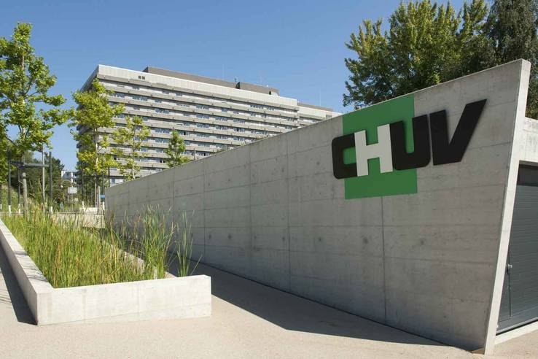
A post script to the Lausanne police: there were two policemen; the older one always asked me what drugs I had taken, I could tell him. I was absolutely furious because I wanted to say “I didn’t take any drugs, there is something else wrong with me”. But I just couldn’t utter a word because I was completely speechless and paralysed.....
I was then ferried to the Centre hospitalier universitaire vaudois (CHUV) where, eventually, the diagnosis was made and it was devastating: it was a severe left-hemispheric stroke followed by a massive brain haemorrhage.

Slide 8
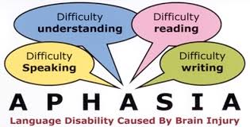
The physical damage was considerable and the prognosis not particularly good:
- paralysis on the right side, i.e. right leg and right arm (I had a stroke on the left brain hemisphere);
- and, worst of all, aphasia.
You can imagine, for me as a linguist and teacher this was particularly devastating…
Notes:
So, that’s more or less the story of me and my stroke

Slide 9
2. Communication Challenges
Notes:
I come to the next section: what communication challenges did I face, in particular with respect to university life?

Slide 10
I would like to illustrate my communications challenges in two areas:
(a) Speech
(b) Writing

Slide 11
(a) Speech
Typical signs of my Broca’s aphasia are stammering and stuttering, word searching difficulties, and laborious speech style. In addition, I also had the following:
phoneme confusion e.g. thin and tin (i.e. Ɵ versus t), ship and sip (i.e. ʃ verus s) or rock and lock (i.e. r versus l) etc;
syntactic disorders such as “telegraph style”: in the beginning, I spoke only in content words and I had no function words, no prepositions, no conjunctions (except the coordinating conjunction and) no is, it, or have, etc;
and, what I called in language rehabilitation, “speaking like a robot”, i.e. the lack of prosodic features, such as stress, rhythm and intonation.
Notes:
phoneme confusion: I could hear the differences, but I was not able to reproduce them! → Training, training, and training again!
syntactic disorders: I would say, for example, “I stroke”, not “I had a stroke”
lack of prosodic features: I had to read aloud, read aloud, and read aloud again, for that helps to improve one’s prosody quite substantially!

Slide 12
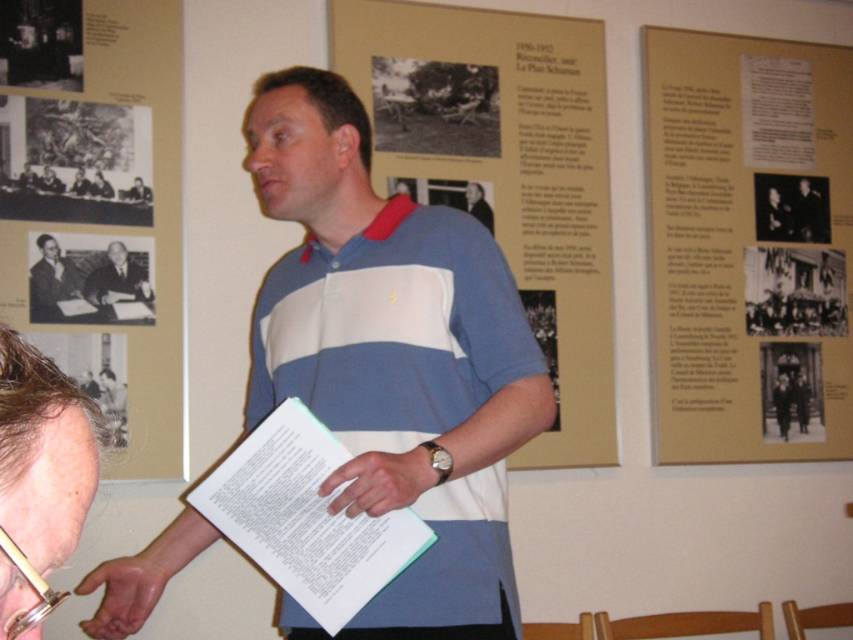
You can imagine, for me as an academic teacher these speech handicaps were not easy at all; I was frightened and very insecure:
- What would I do with with my lectures and seminars at the University of Lausanne?
- What with public speaking, radio talks, and conference presentations?
?
Notes:
I simply didn’t know and I was frustrated and, at times, very angry.

Slide 13
(b) Writing
Writing is obviously very, very important for an academic. But for me, expressing spoken sounds into written letters was most difficult. In speech therapy, I wanted to write the letter “a” but what I wrote was the letter “c”…
Today, I can spell short words again (ca. up to 5 letters) but everything
longer is beyond me. I am prone in particular to the following:
- omit the middle of words, so that e.g. excitable can be written as excible
- to scramble the middle of words, e.g. excruciating is written as excru-ic-ating
- generally speaking, it’s “easier” when I have pre-fixes and suffixes into which I can separate the words (e.g. bio-de-grad-able vs. psychologist).
Notes:
And so to writing, for me another great obstacle.

Slide 14
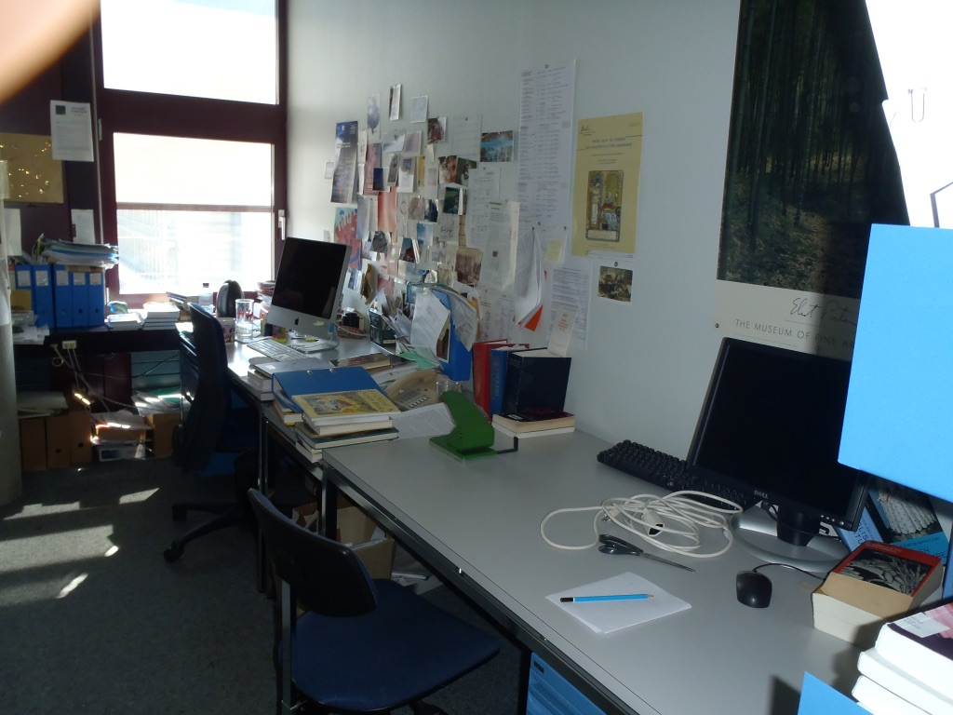
How would I write my scientific papers, finish the book which I had started, or even just function in university life with e-mail, writing lecture notes, and the plethora of administrative memos and letters?
I was really not sure whether I could continue my university career and if so, how………
?
Notes:
The solution to all these problems, my solution, we shall now see.

Slide 15
3. Strategies to overcome the communication handicaps
Notes:
How did I overcome these communication handicaps?

Slide 16
(a) Speech
My solution to the problem was really threefold:
I stopped giving conference presentations, radio talks and and seminars because there was simply no way in which I could handle spontaneous, unscripted speech, and the question-and-answer sessions in seminars;
instead, I gave only MA lectures on a “Stroke and Aphasia”, knowing the students would understand my communication difficulties well;
- and, most importantly, I scripted everything (even the jokes!) and I then practice and practice again the pronunciation and the articulation (about 10 to 15 times) so that you, the audience, can hear it more or less alright.
→ It needs a lot of time, effort and work but, generally speaking, it worked very well.
Notes:
(a) Speech: You remember, that I faced particular difficulties finding words, stammering and stuttering, phoneme confusion and a syntactic disordered such as “telegraph style”.

Slide 17
(b) Writing
There are many technological aids nowadays that help you overcome one’s writing handicap. “Siri” on the computer and the “dictating function” on the mobile phone are just two of them.
But, I struggle with (at times) incorrect trans-criptions, misunderstanding of a word, and cumbersome ways to correct. Even more so, as my spelling isn’t what it used to be….
Notes:
(b) Writing: You remember that writing anything longer then 5 letter-words is a problem for me as well as omitting or scrambling the letters of longer words. What strategy did I apply to overcome this handicap?

Slide 18
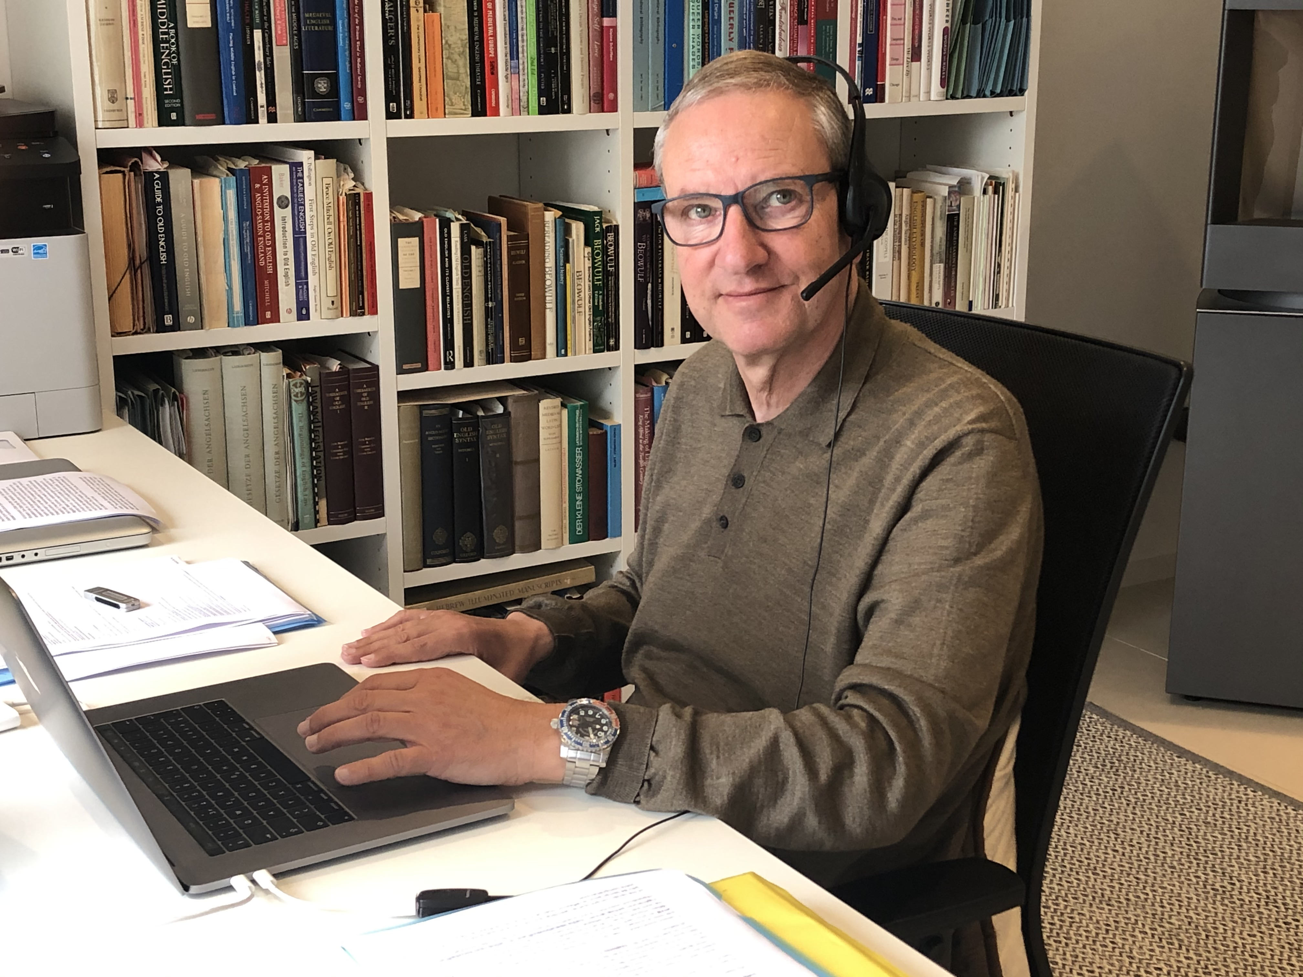
I have come to rely on advanced speech processing software, “Dragon”: it works for me because it is a bilingual speech recognition program, always with English, where I dictate to the computer and the computer types the text into the file. And this is my lifeline to the outside world!
Notes:
I have, for example, the French-English and the German-English programs…..

Slide 19
The software makes fewer and fewer mistakes as it learns with you, adapts very quickly to the way you speak, and, should you need it, corrections are easy and straightforward.
It has also the advantage that it can be used it for every programme on the computer, from “Word” to my Internet browser and from “Google Maps” to “Stickies.”
There is only one problem with the “Dragon” software: it isn’t manufactured any more for the latest “MacBook Pro”.
So I have to keep an old MacBook in order to transcribe speech to text….

Slide 20
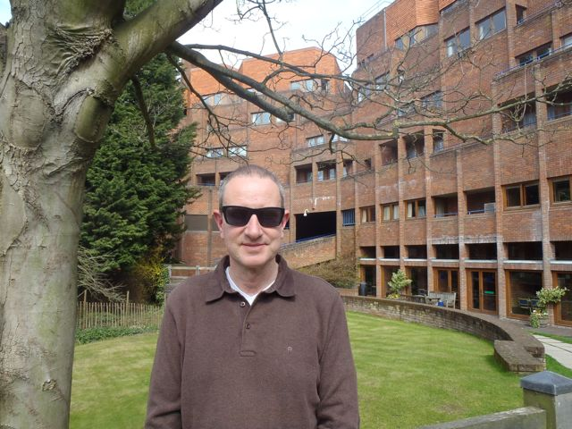
As an example, I wrote this piece on PowerPoint with “Dragon”.
And, as another example: I finished the book, the research of which I had begun pre-stroke. In the summer of 2013 I took a sabbatical, and me and my partner went to Cambridge, where I had an invitation from Robinson College.
Although I had most of the research done pre-stroke, I wrote with “Dragon” for about 2-3 hours per day.
→ It took me about 4 months of solid hard work to write the book in rough draft.

Slide 21
Finally, Oxford University Press published my book on BBC language policy in May 2016, after revisions and quite a bit of editorial work.
And I must say, I am particularly proud of it because I wrote it as a stroke survivor!
Notes:
Dictating to the Mob: This History of the BBC Advisory Committee on Spoken English

Slide 22
Conclusion
I have illustrated how I (more or less) master my communication challenges, and I have outlined the strategies I used to overcome them.
But in sum, I would say that it is particularly the invisible handicaps (such as aphasia) that still pose the greatest problems to me.
But my recommendation as a stroke survivor is very simple: never give up and never lose hope, no matter how hard your communicating challenges are; there is always a solution!

Slide 23
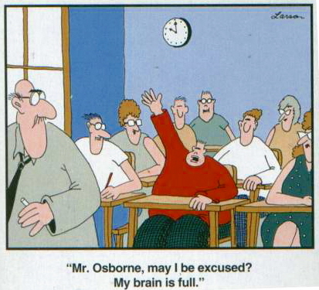
Thank you so much for listening!
jr.schwyter@bluewin.ch jurg-schwyter.ch

