Slide 1
Challenges and Strategies Living with Stroke and Aphasia Alexia Kountouri Stoke Ambassador at Cyprus Stroke Association

Slide 2
Who I am?
I am Alexia Kountouri
I am 34 years old
I am Social Work
I had a STROKE in May 2015
My right side was paralyzed
I am a SURVIVOR!!!

Slide 3
What happened…
In the work I noticed that my speech was not right.
I called a colleague and as soon as arrived my speech was lost.
She CALLED an ambulance.
In the hospital after the examination (X- ray).
I diagnose with hemorrhagic stroke.
I had to undergo surgery.
In the hospital I was in the emergency room for 3 days.
I was in hospital for 1 month.
My speech was lost. I couldn't speak at all for 1 month
To express myself was very hard and annoyed.

Slide 4
FEARS
What is STROKE?
FEAR of the unknown
Anxiety
What to expect from recovery?
CAN I GET MY SPEECH BACK!!!!!!!

Slide 5
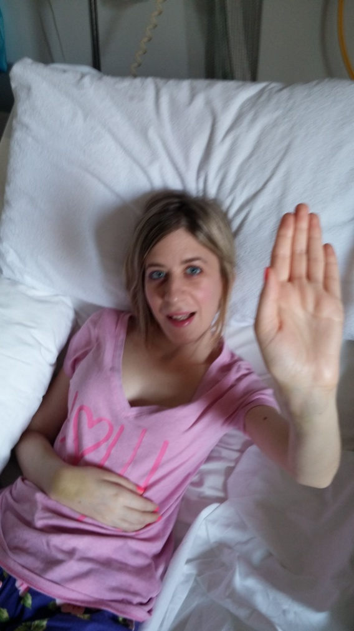
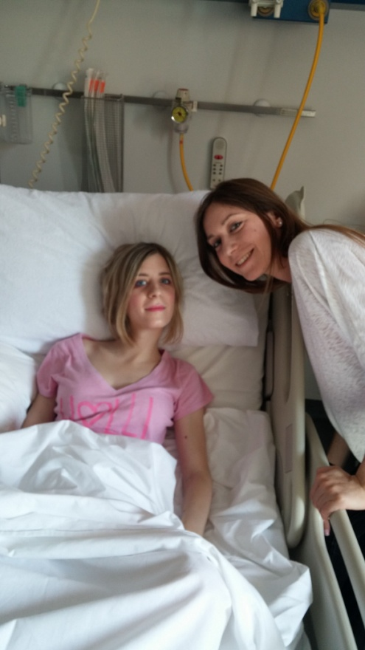
In the hospital
FEARS

Slide 6
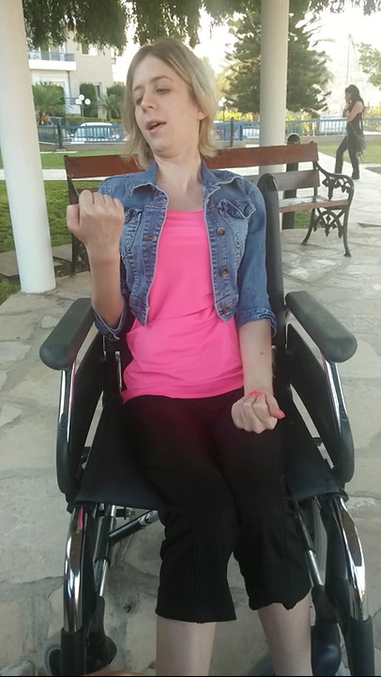
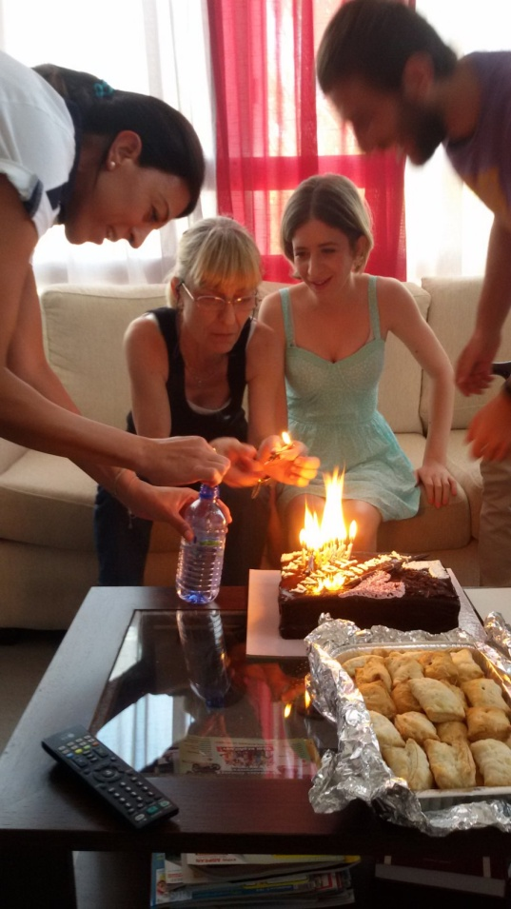
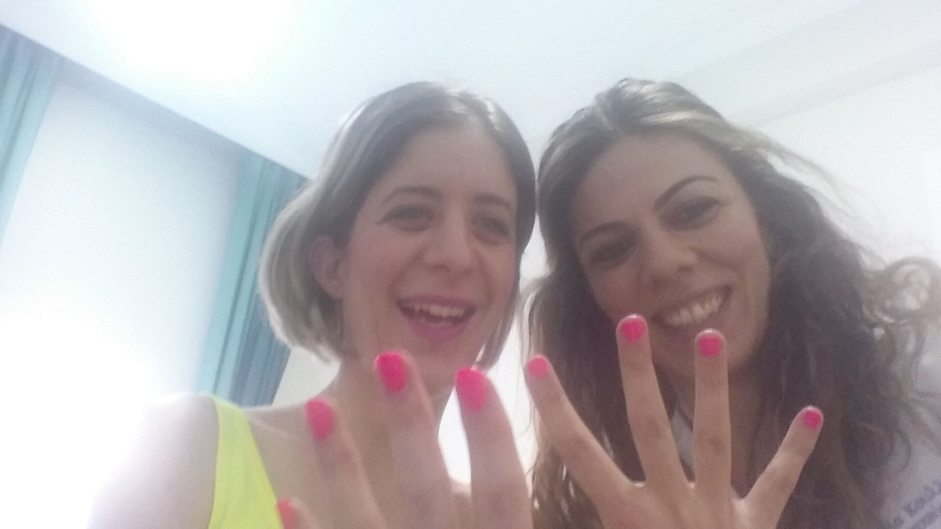
My rehab in Cyprus, in Limassol
With occupational therapist
Happy Birthday to me!!!
On wheelchair try to move my arm.

Slide 7
CHALLENGES
After 2 years (2017) of my stroke I moved in UK to continue my studies in PhD.
Due to lack of time I could not complete it.
Nevertheless, I retuned to England in Brighton, I lived alone, I went to the University by walking, doing shopping from the supermarket, I was able to catch buses, trains, planes.
Fully independent

Slide 8
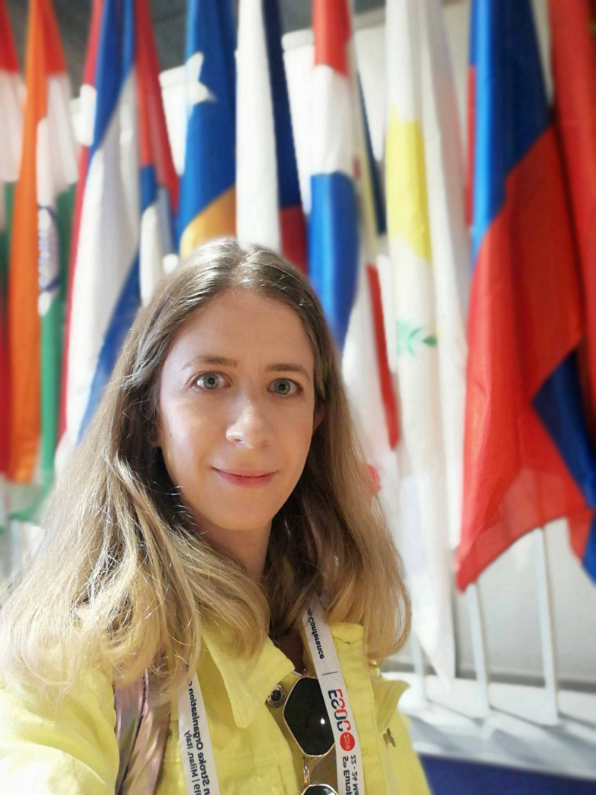
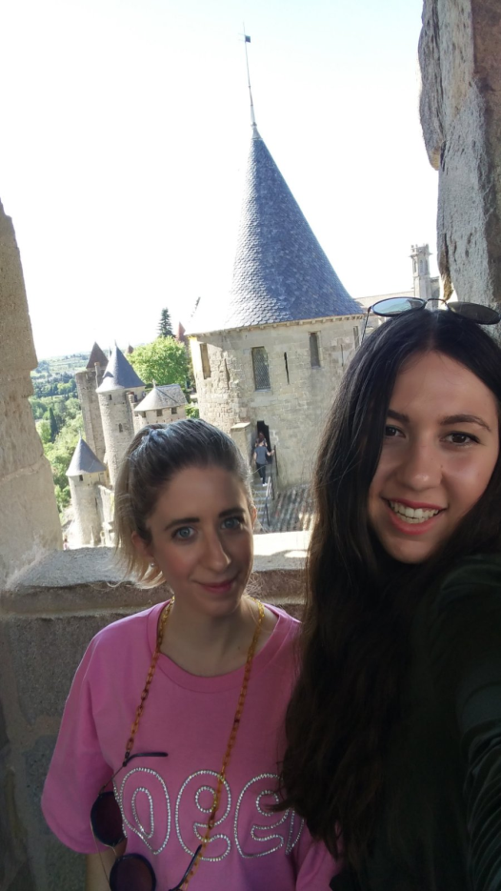
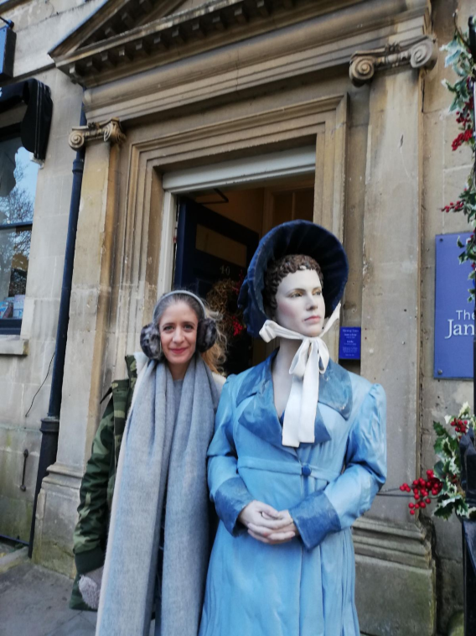
Trip in Bath in UK
Trip in Carcassonne in France
Trip to Milan for ESOC conference

Slide 9
STRATEGIES Aphasia
Acceptance - accept communication has worked and information been transmitted and that should be adequate - don’t overcorrect the person
Try to find another way to communicate more personalized like gesture, showing pictures, writing.
Communication - give your loved one directions, questions or pieces of information one at a time, speak slowly, use short, simple sentence.

Slide 10
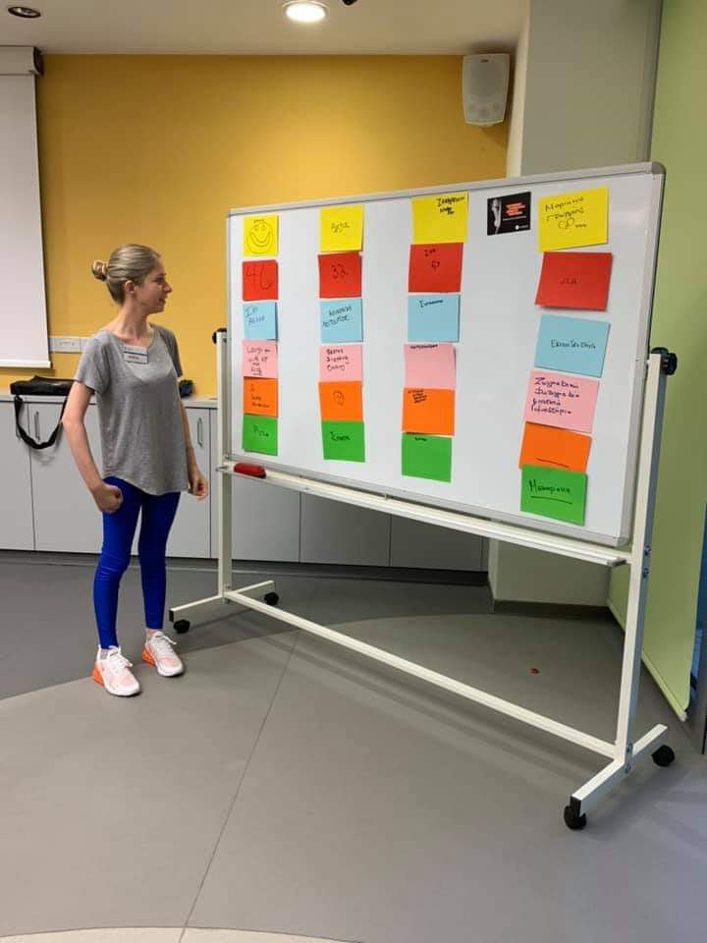
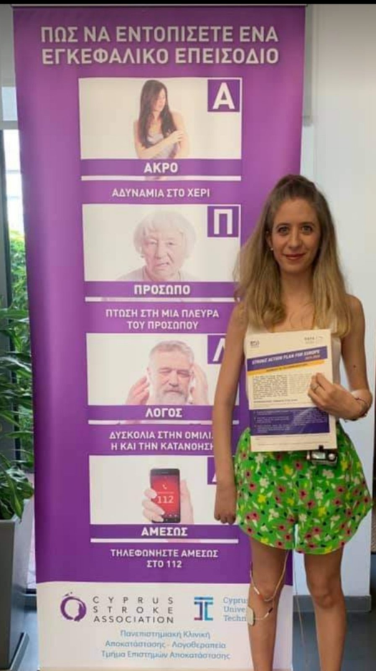
Speech and Language therapy
Aphasia Communication
group -present myself
ΑΠΛΑ – FAST in Greek

Slide 11
LIFE AFTER STROKE
Today, I walk independent, I CAN SPEAK
Being a stroke survivor, I have spent some time to term with my disability and develop my own ways of adapting, coping and solving problems.
I believe that this attitude has contributed to my positive approach to life.

Slide 12
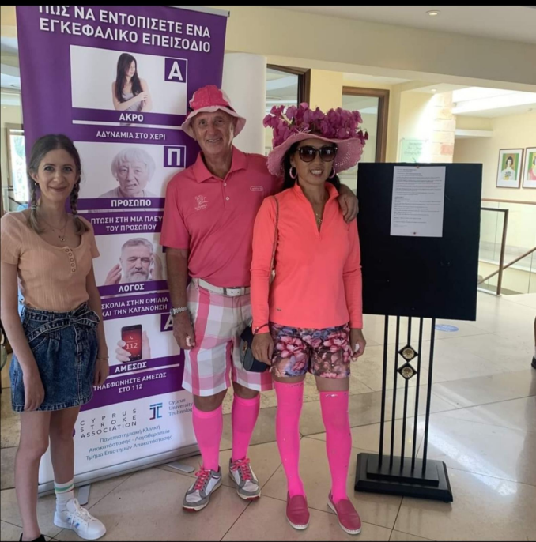
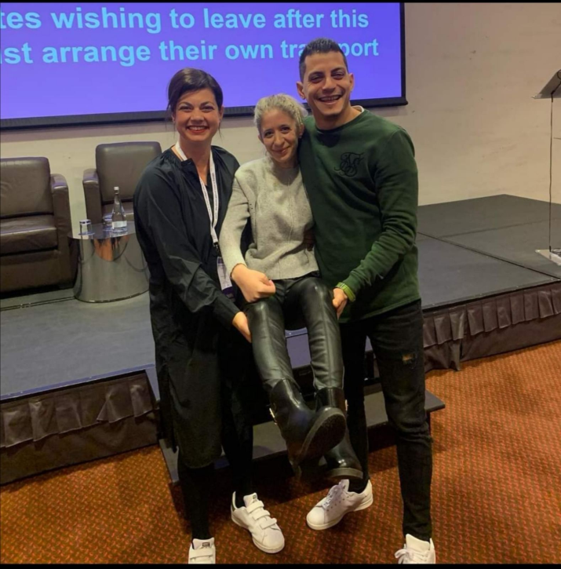
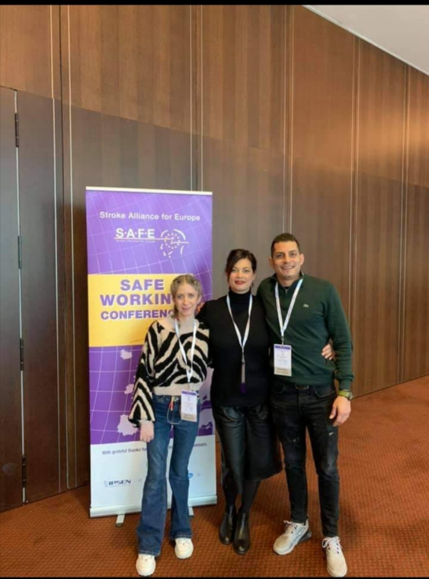
Trip in Paphos in Cyprus at golf Cyprus Association in Cyprus
Porto conference my team!!
Porto conference my team!!

Slide 13
Cutting my nails
https://photos.app.goo.gl/yPZ4VyQQRmfJc9ZK7

Slide 14
My 1st walk in Brighton
https://photos.google.com/share/AF1QipPSCPGyincyU9vw0Y3_jl8YXUVJWhRj6d3YfB-4DYuO77_XWXY7mL8mrY9rFmvjWQ/photo/AF1QipOVMSocZPLIfzuw7yc8Y8QnZKCS_FLSqO4GP1T-?key=bEJuekFkUmllZHNPQTcyTDhqSHVlNGtWd2hWRmNR

Slide 15
After 2 years in Brighton
https://photos.google.com/share/AF1QipPSCPGyincyU9vw0Y3_jl8YXUVJWhRj6d3YfB-4DYuO77_XWXY7mL8mrY9rFmvjWQ/photo/AF1QipOyQs1JpnMeKIyM5k-nJn53UJPyaQlZl2B3q1Cr?key=bEJuekFkUmllZHNPQTcyTDhqSHVlNGtWd2hWRmNR

Slide 16
I am Ambassador for STROKE in Cyprus standing next to stroke survivor and their families

Slide 17
Thank you for listening!!!

