Slide 1
1st European Life After Stroke Meeting 11th March 2022
Michalatou Mina
Stroke - a young professional mother's world of communication
Notes:
Good afternoon, ladies and gentlemen. It is an honor to be here and share with you my stroke experience from a young mother’s world aspect of communication

Slide 2
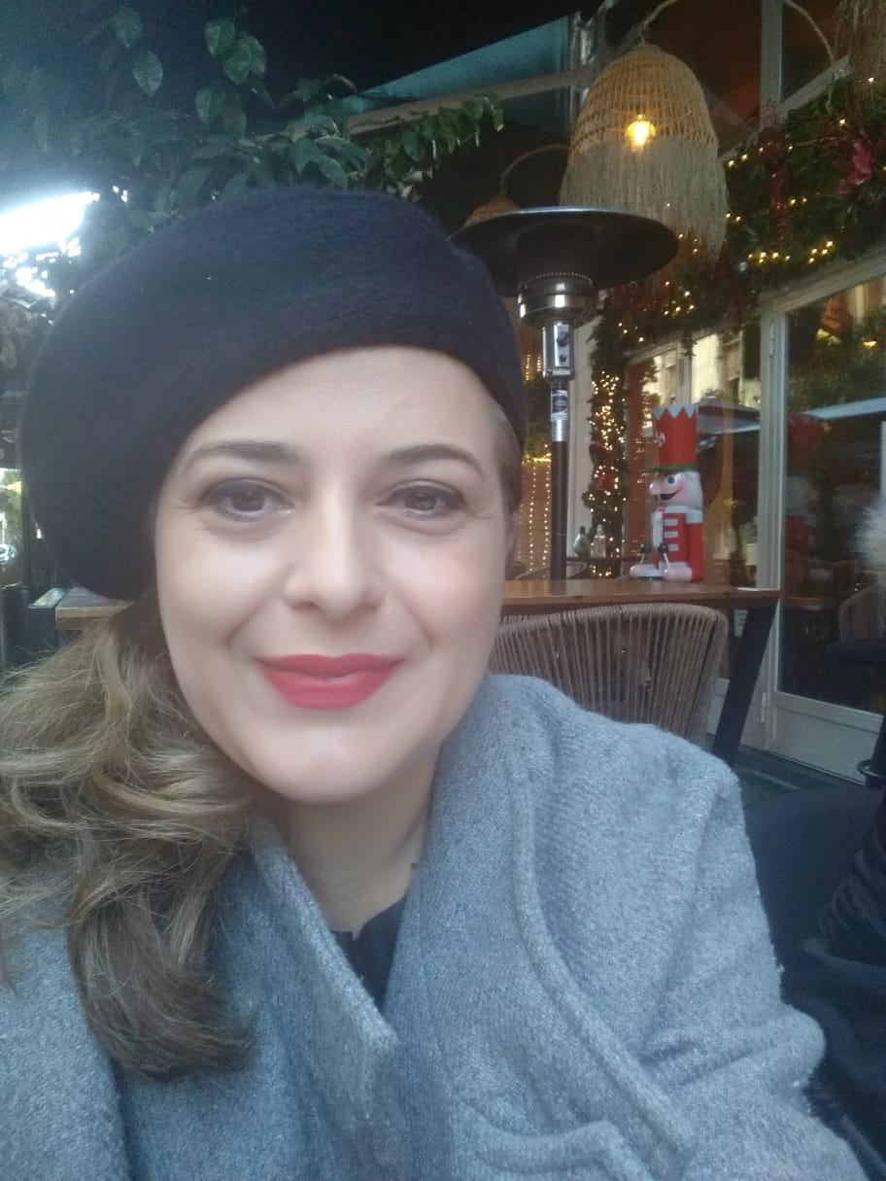
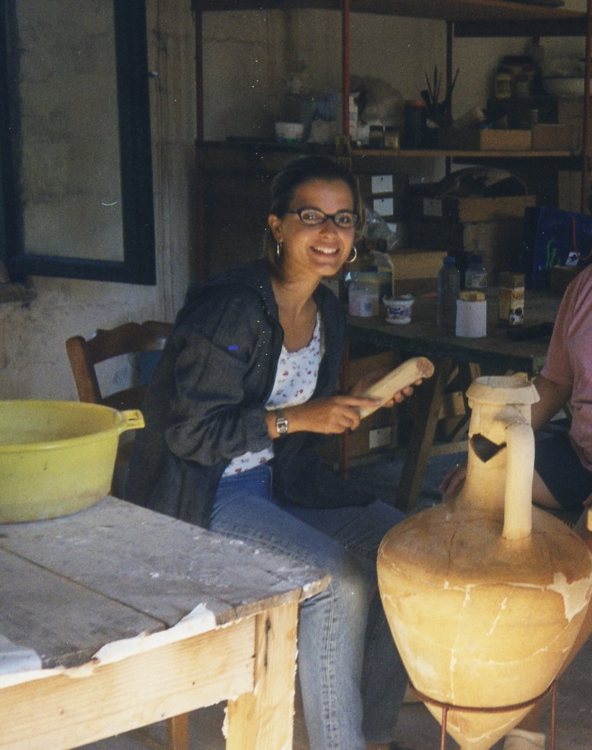
WHO I AM
I am Mina Michalatou, from Thessaloniki, Greece and I am a stroke survivor.
I have worked as an archaeologist, taking part in various excavations in Greece revealing the past.
Notes:
First of all, let me introduce my self.

Slide 3
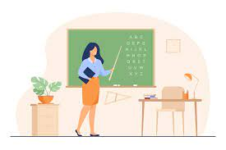
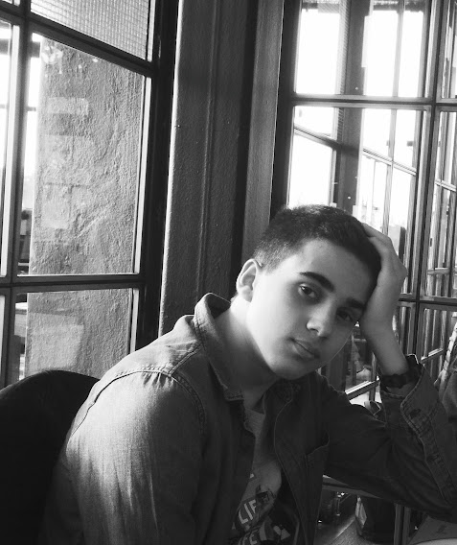
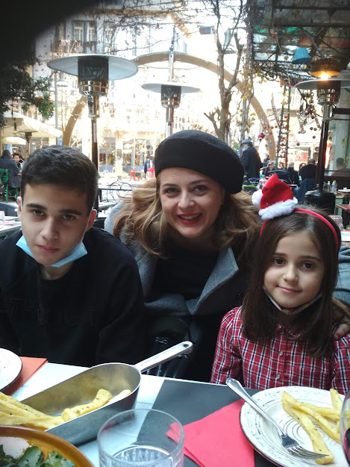
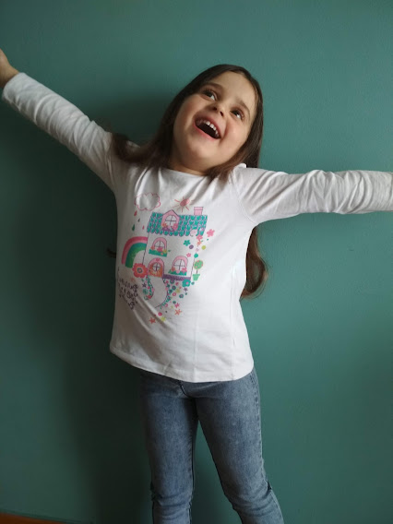
The last 5 years I have been working as a teacher of the Greek Language or Greek as a Second/Foreign Language.
I am also a mother of two children, Orpheus, a 14-year-old boy and Danae, a 7-year-old girl.
Notes:
I’ve always been passionate with both, my family and my job, until stroke came into my life, at the age of 43…!

Slide 4
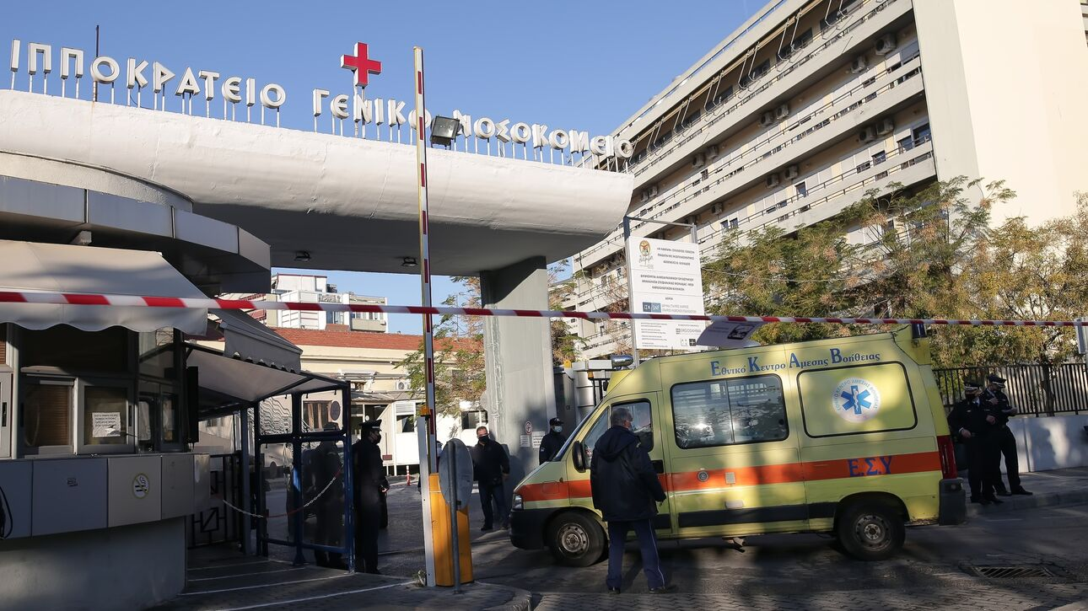
WHAT HAPPENED-DISEASE COURSE
STROKE DAY: FRIDAY, 12th DECEMBER 2019
CAR ACCIDENT: on my way to the neurologist’s I crashed twice the leading car, fortunately with no injuries or damages on both sides, as the cars were driving from bumper to bumper due to traffic.
MY NEIGHBORHOOD’S SUPERMARKET: lost consciousness
TRANSFER TO THE "HIPPOCRATIC GENERAL HOSPITAL OF THESSALONIKI"
TILL THAT DAY:
very intensive period of long hours of work,
lack of sleep and
exhaustion, which was straining me day-by-day, physically and psychologically
trying to recover from a personal psychological trauma
Notes:
It was Friday... It all happened within a week and it ended up after a car accident and a fainting episode a few hours later, in front of a cashier asking me…“Will you pay in cash or with a card”…I remember, my brain was totally confused! After half an hour I was found unconscious at the emergencies.
Till that day, …I was feeling like burning out …

Slide 5
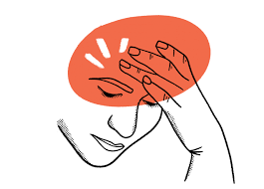
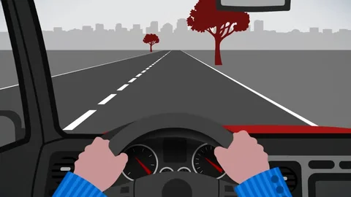
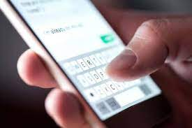
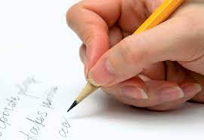
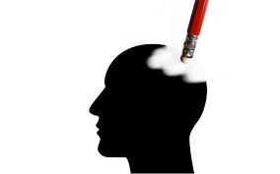
Symptoms within a week before the stroke
Headaches
Visual-spatial misperception, especially during driving
Difficulty in texting through my cell phone
Instability in written speech, especially in my hand writing
Memory disorders, particularly in the use of ATM machine
or recalling the steps of taking a picture through my phone!
Notes:
For about a week, I was wondering what was going on with me, as I had

Slide 6
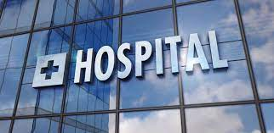
Clinical Picture-Diagnosis
Hospitalization for about 15 days.
Diagnosis: multiple ischemic strokes on my left side, temporal visual fields deficits at both eyes, no other pathological findings, other than the presence of positive thyroid antibodies
The stroke didn’t affect my mobility
The basic communication did not present any serious disturbances. Understanding verbal communication was not affected.
Main difficulty in further communication, mainly in the semantic memory and in naming and writing words (simple copying and free production of syntactically correct sentences).
Notes:
I stayed at the hospital for about…
Fortunately, I was probably given a second chance as the stroke didn’t affect my mobility.

Slide 7
CHALLENGES AFTER STROKE
Notes:
I had no obvious deficits. Everyone thought that my life could be just as I left it before the stroke! But, inside my brain, there were hidden post stroke difficulties I had to face, related to cognitive issues…

Slide 8
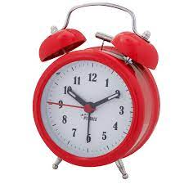
The most difficult challenge was to balance my life goals and family needs, in order to optimize my quality of life in relation to home, work and education
Writing skills deficiencies: my hand writing couldn’t follow my brain thoughts
Time-Management issues: run out time
Short term memory: especially verbal memory, such as naming items on a shopping list or have a conversation.
Concentration: couldn’t multitask and focus
Depression: persistence sadness, mood swings, anxiousness
Fatigue: feel very tired after stroke, both physically and mentally
Notes:
*Problems with language and writing can make it difficult to find the right words to say, to name objects correctly or do mathematical calculations.
*My memory, especially short-term memory, was affected by the stroke. Sometimes, I was not be able to retain what happened five minutes ago.
I had problems with my verbal memory, such as naming items on a shopping list or during a conversation.
During the first period, I was always running out of time
Stroke survivors are at high risk of developing emotional problems such as depression and mood swings after a stroke. Depression often goes undiagnosed and untreated. I had all the symptoms: persistent sadness, anxiousness or “empty mood,” feelings of hopelessness
As a mother of 2 children, I couldn’t multitask as in the past and-the most important-I couldn’t focus on one thin for a long period

Slide 9
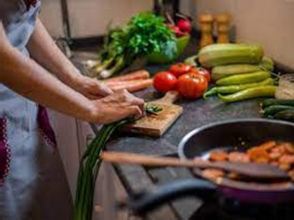
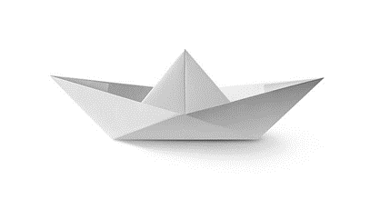
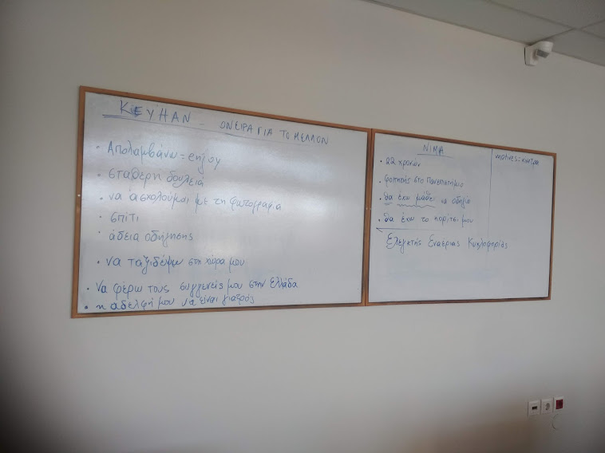
Driving: drive my kids to school every morning
Cooking: couldn’t recall the steps of making my children’s favorite food or how to make coffee or a tea
Recreational time with the family: couldn’t recall how to make a paper boat for my daughter, when she asked me to
The return to work for younger stroke survivors as in my case, was more than a desideratum.
Teaching my students: difficulty in explaining grammar rules or write in a non native language (English)
OR
when my son had a question at an exercise in the lesson of ancient Greek
Notes:
After the stroke, Ι wasn’t aloud to drive for some time. My car used to be so helpful, since every morning I had to drive my small daughter to school

Slide 10
STRATEGIES AFTER STROKE
Notes:
Due to the fact that I had no obvious deficits, everyone thought that my life could be just as I left it before the stroke! But, inside my brain, there were hidden post stroke difficulties I had to face…

Slide 11
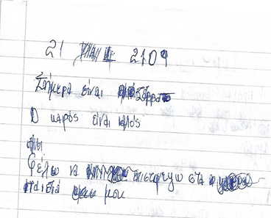
It was proved that my coming back to real life was a matter of strategy!
STRATEGY nr. 1
Beautiful quotes from books that I read during my hospitalization and afterwords were copied in a note notebook!
Coping Jorge Bucay’s passages from Stories for Thought (1997)
Notes:
Here you can see my first day of attempting to copy some passages from books, Jorge Bucay’s Stories for Thought (1997) that my friend, Eugene, gave me to keep me company, when I was alone in hospital! I am so grateful for that Eugene…and for the selection of the book, of course!
You can see the scribbles I made. I had difficulty in writing the correct letter, especially when it was a consonant, I couldn’t decide which was the correct letter and I wrote D instead of B etc.

Slide 12
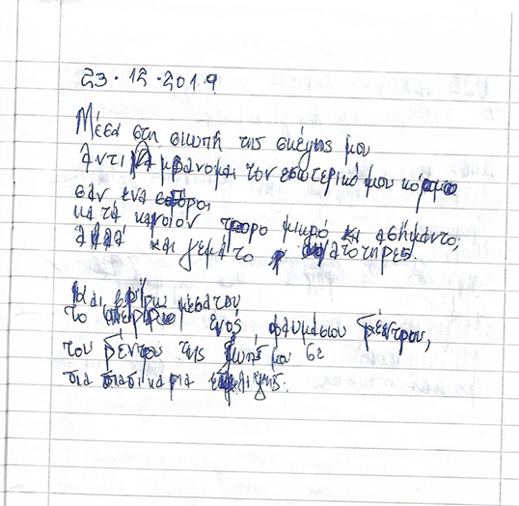
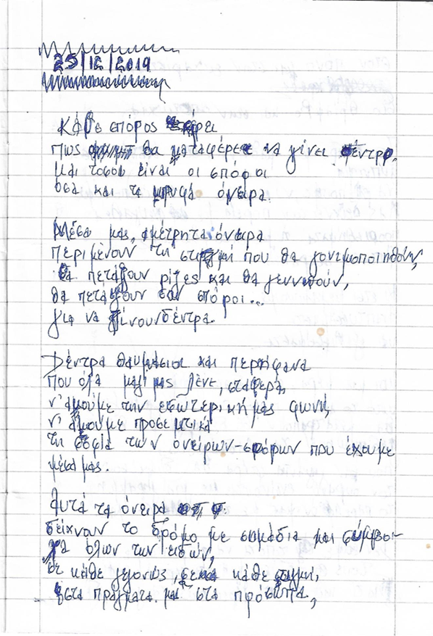
Notes:
Here is my progress the 2nd and the 3rd day! It’s the same passage, but it has less scribbles and it’s a longer text, as you on your right!

Slide 13
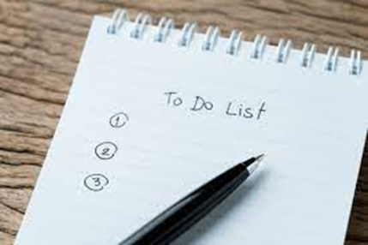
STRATEGY nr. 2
My phone became by best friend
STRATEGY nr. 3
It also helped with finding through the web our family’s favorite recipes to cook.
STRATEGY nr. 4
Keeping shopping or - to do lists -was also very helpful!
Notes:
STRATEGY nr. 2
My phone became by best friend in terms of time management issues, reminding, writing/texting.
STRATEGY nr. 3
It also helped with finding through the web our family’s favorite recipes to cook. I tried to copy some of them in a cook notebook, in order to improve my handwriting, as well.
STRATEGY nr. 4
Keeping shopping or - to do lists -was also very helpful!

Slide 14
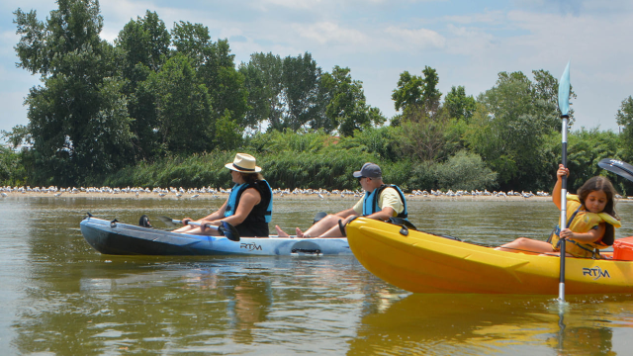
STRATEGY nr. 5
Community reintegration is one of the most important elements of stroke rehabilitation!
Joining in stroke support groups, like the stroke club of the Hellenic Alliance for Stroke (HAS SSO)
opportunity to share experiences by talking to others in the same situation
learn more about stroke and how to cope with it
feel less isolated and more confident about life after stroke
Keep connection with close friends and family
Playing table games with my kids
Small walks in the fresh air and out-door activities
I am so thankful for my friends’ and relatives’ patience and support, especially my husband and my kids!
Notes:
Joining in stroke groups, like the stroke club of the Hellenic Alliance for Stroke (HAS SSO)
opportunity to share experiences by talking to others in the same situation.
learn more about stroke and how to cope with it
feel less isolated and more confident about life after stroke

Slide 15
STRATEGY nr. 6
COME BACK TO WORK-TEACHING
After a stroke, returning to work is no easy task. For many younger, previously working stroke survivors, it provides a sense of social identity and the confidence to begin to step forward!
the first period I tried to reduce the hours of my lessons in the afternoons.
instead of keeping notes on board or on paper, I handed out photocopies.
in some cases we had online lessons with more interactive material through the web!
This opened to me a whole new world with plenty of ideas during the lesson!

Slide 16
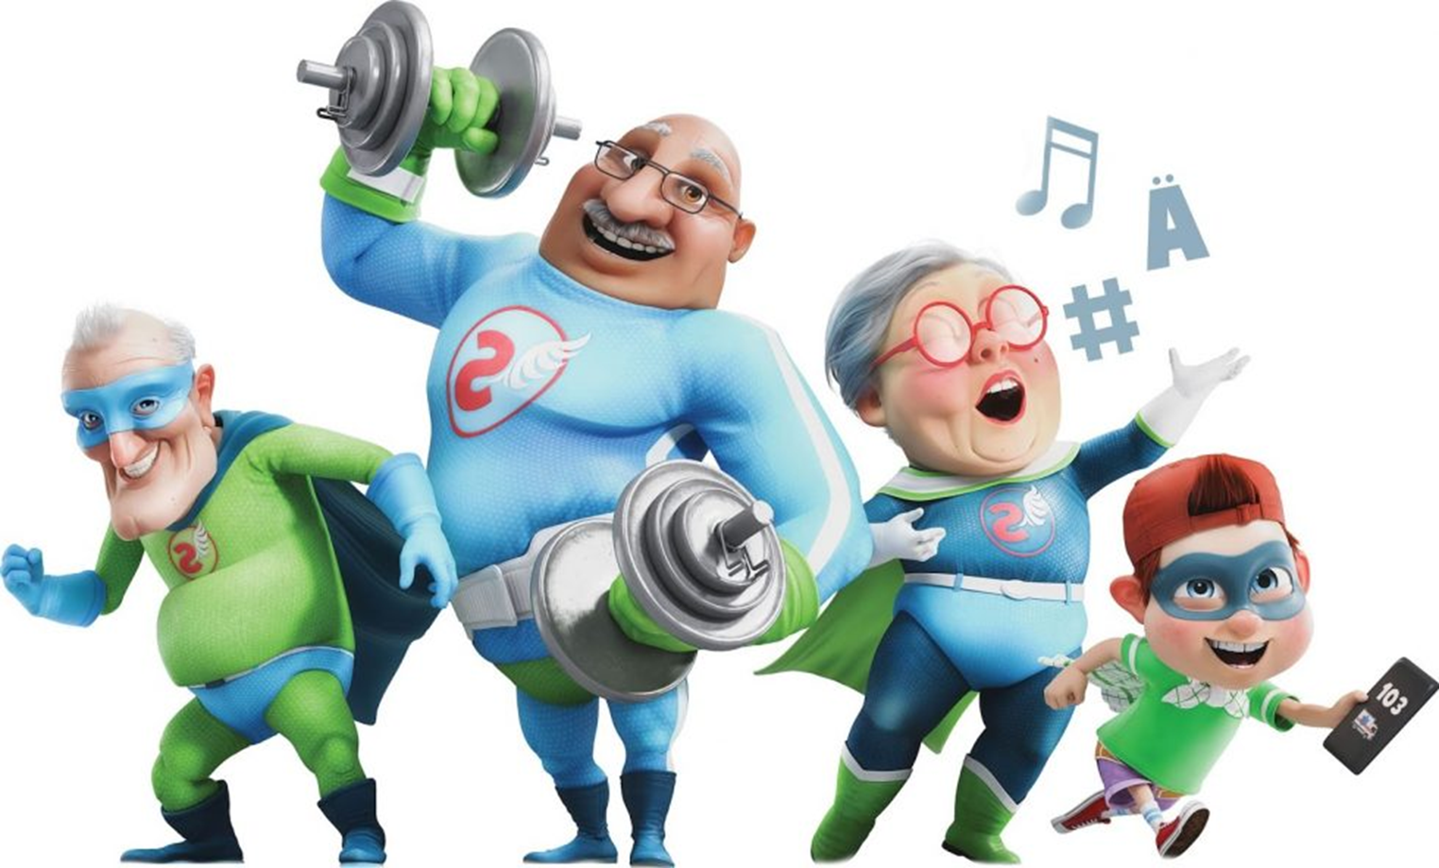
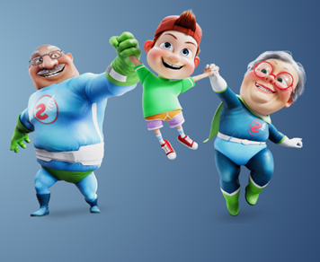
STRATEGY nr. 7
Involvement in campaigning on stroke issues, as a means of vocational and stroke rehabilitation
“FAST Heroes 112” globe campaign (www.fastheroes.com)
developed by the Department of Education and Social Policy of the University of Macedonia, Greece with the support of the Angels Initiative.
Primary school children across the world are encouraged to become potential lifesavers by participating in an award-winning educational campaign.
central character, Timmy (Aλέξης in Greece), who becomes a FAST Hero by learning how to beat the Evil Clot and save the Grand heroes in his life (his grandparents).
resources for use in class (short film animations, classroom activities and take-home materials) to literally hit the message home.
Notes:
When I met my speech therapist, after evaluating my situation, the first thing that she advised me to do, was to take part in “FAST Heroes 112” educational program campaign, as it could help me feel again active and optimistic about my life. So, I joint volunteerly. "The FAST Heroes campaign is developed by the Department of Education and Social Policy of the University of Macedonia, Gree and has been made possible by the support from the Angels Initiative

Slide 17
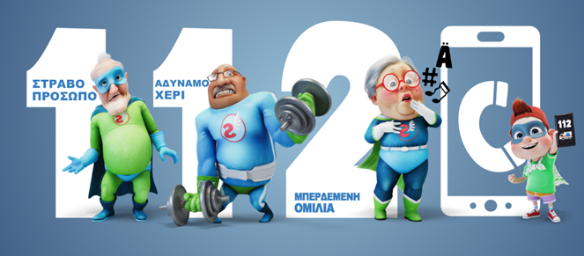
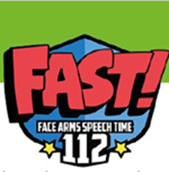
In the educational process the children have the help of 4 “FAST Heroes 112”- “X.O.Π.Α. Ήρωες 112”, who are three retired superheroes and their grandson. Each of them has a superpower, that will help families recognize and remember the most common symptoms of stroke, which are recognized by the Neurological Association of Greece and are well published in the literature.
The acronym F.A.S.T. in Greek is translated as X.Ο.Π.Α., which stands for: Arm, Speech, Face and Time
X - ΧΕΡΙ – ARM
O - OMΙΛΙΑ – SPEECH
Π - ΠΡΟΣΩΠΟ – FACE
Α - AΜΕΣΩΣ – ΤΙΜΕ
Notes:
The campaign targets young children and their grandparents.
The purpose is to teach children to recognize the three most common stroke symptoms: an arm suddenly becoming weak; the speech that is slurred, or broken. And
the face suddenly drooping to one side

Slide 18
Active participation in the pilot virtual implementation of the educational program “Fast Heroes”
The pandemic health emergency of COVID-19, led the scientific team of “Fast Heroes 112” in Greece to seek for new ways of implementing the program and to redefine it in a more online form.
Given the quarantine lockdown, which kept children away from their loved ones, such as grandparents, it was an opportunity for them to show how much they love and care about their grandparents.
Many children from various cities in Greece and Cyprus participated in the pilot online implementation of the program.

Slide 19
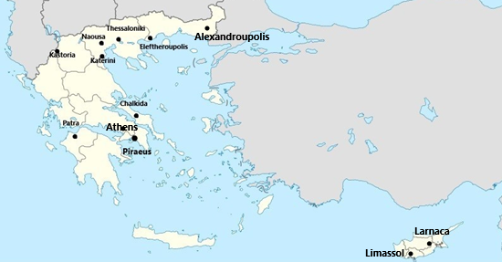
The pilot virtual implementation of the educational program “FAST Heroes” was conducted during the first wave of the COVID-19 pandemic in various cities in Greece as well as in Cyprus with promising results and acceptance.

Slide 20
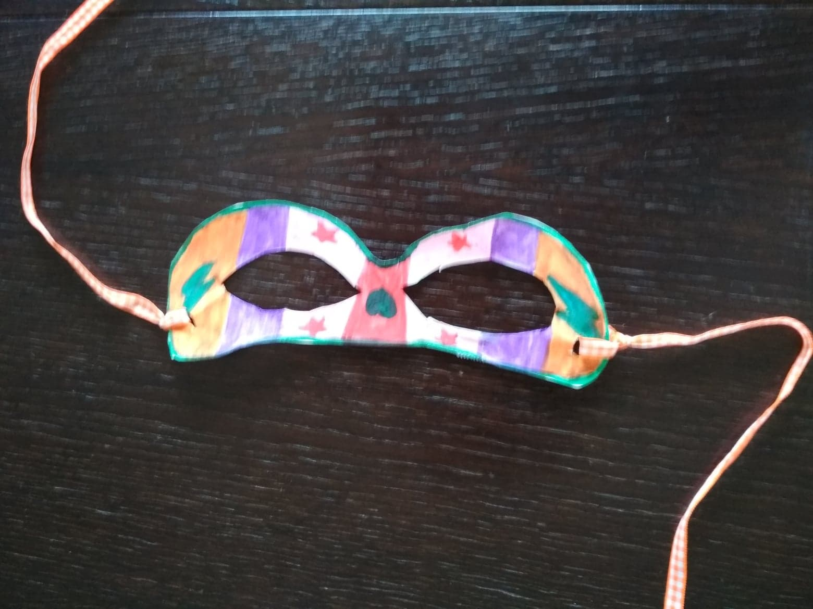
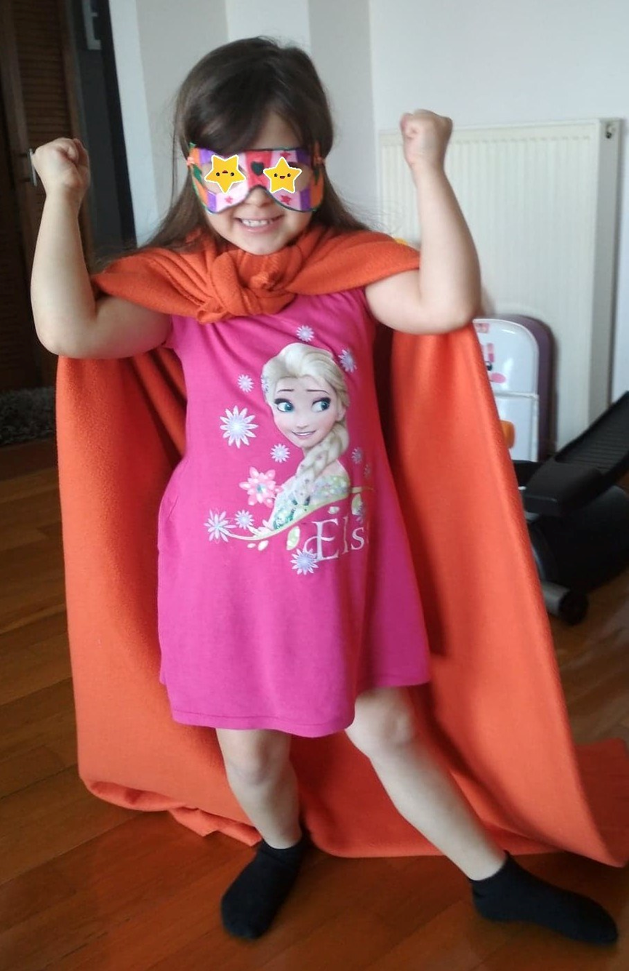
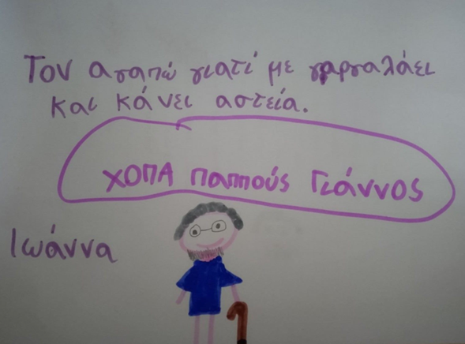
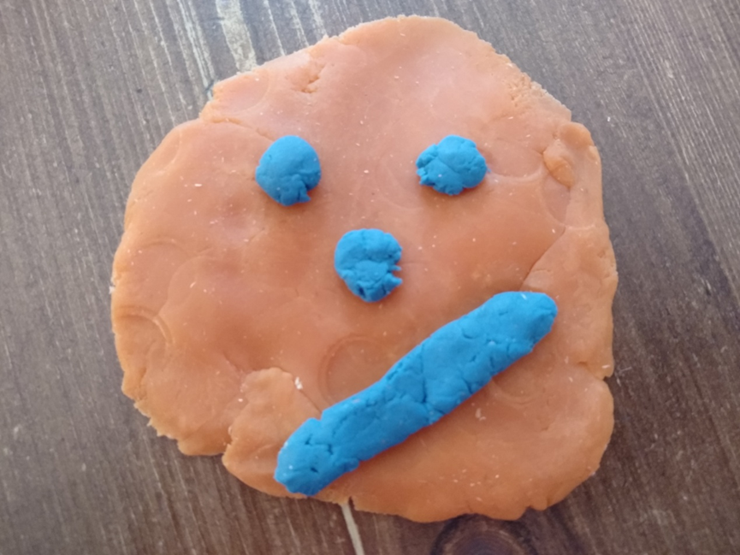
Welcome to the “FAST Heroes” team!
Notes:
Among them, my small daughter, Danae and her friends, or our family friends and some of my students!

Slide 21
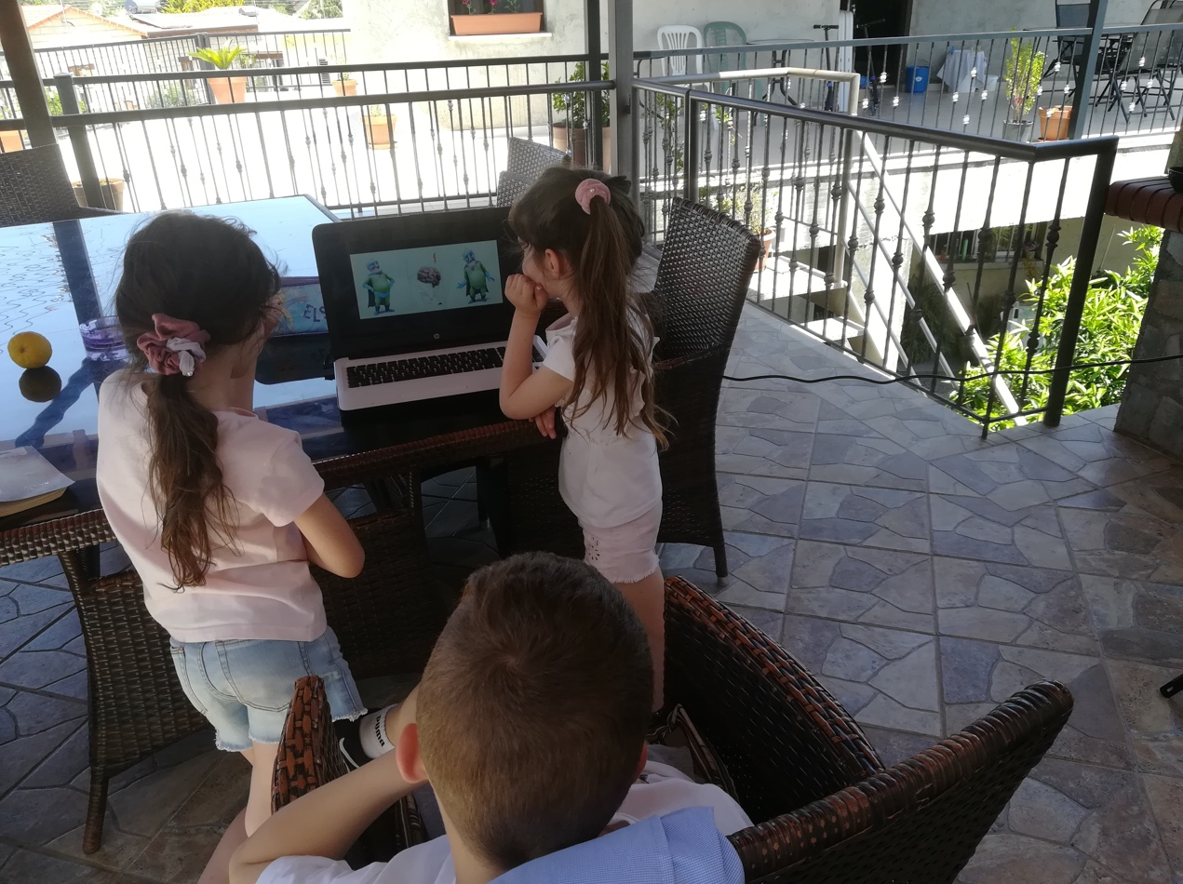
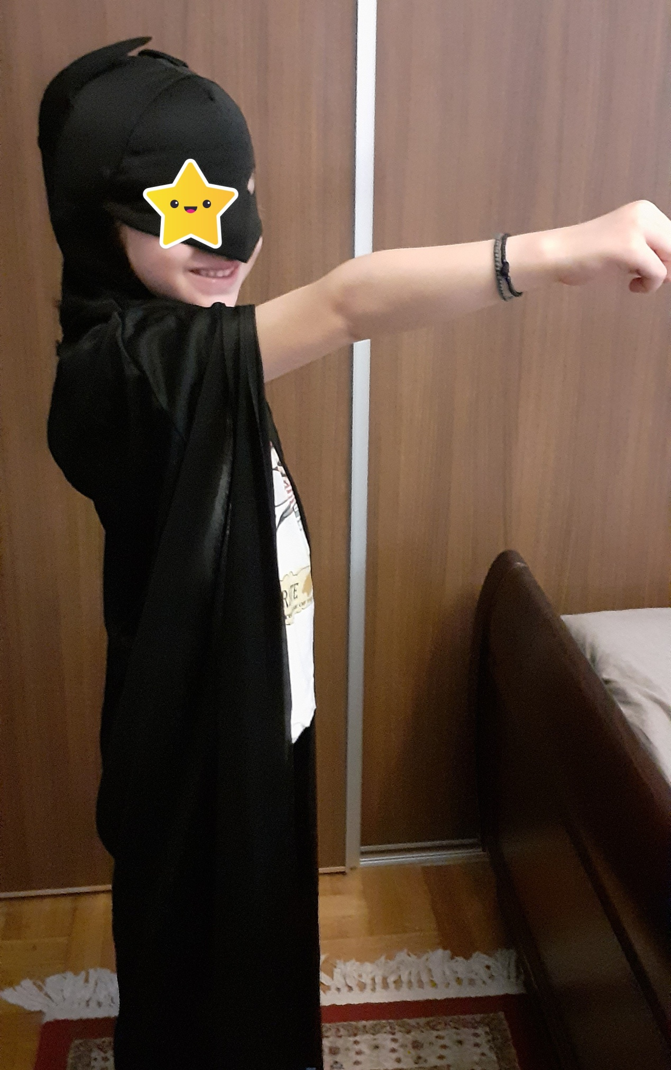
Children learning how to become superheroes
and save a life!

Slide 22
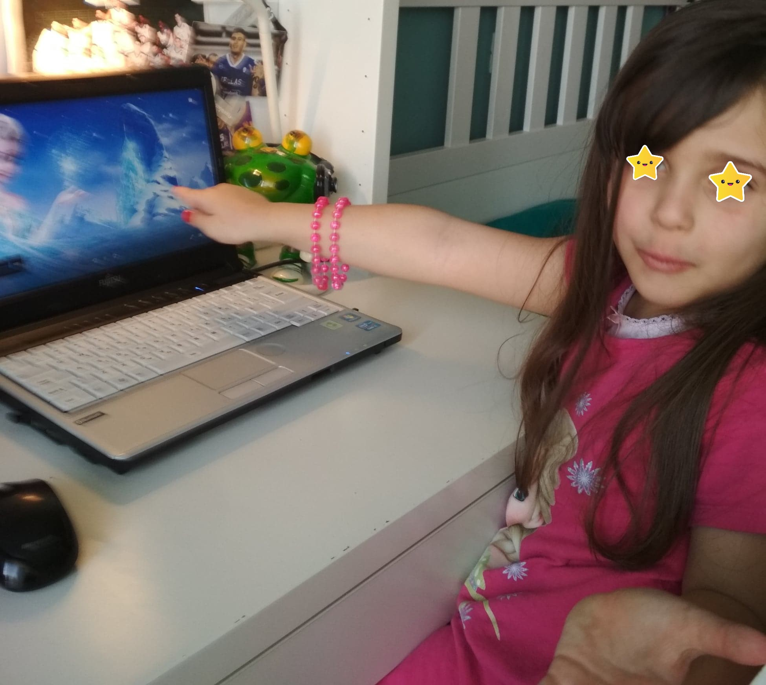
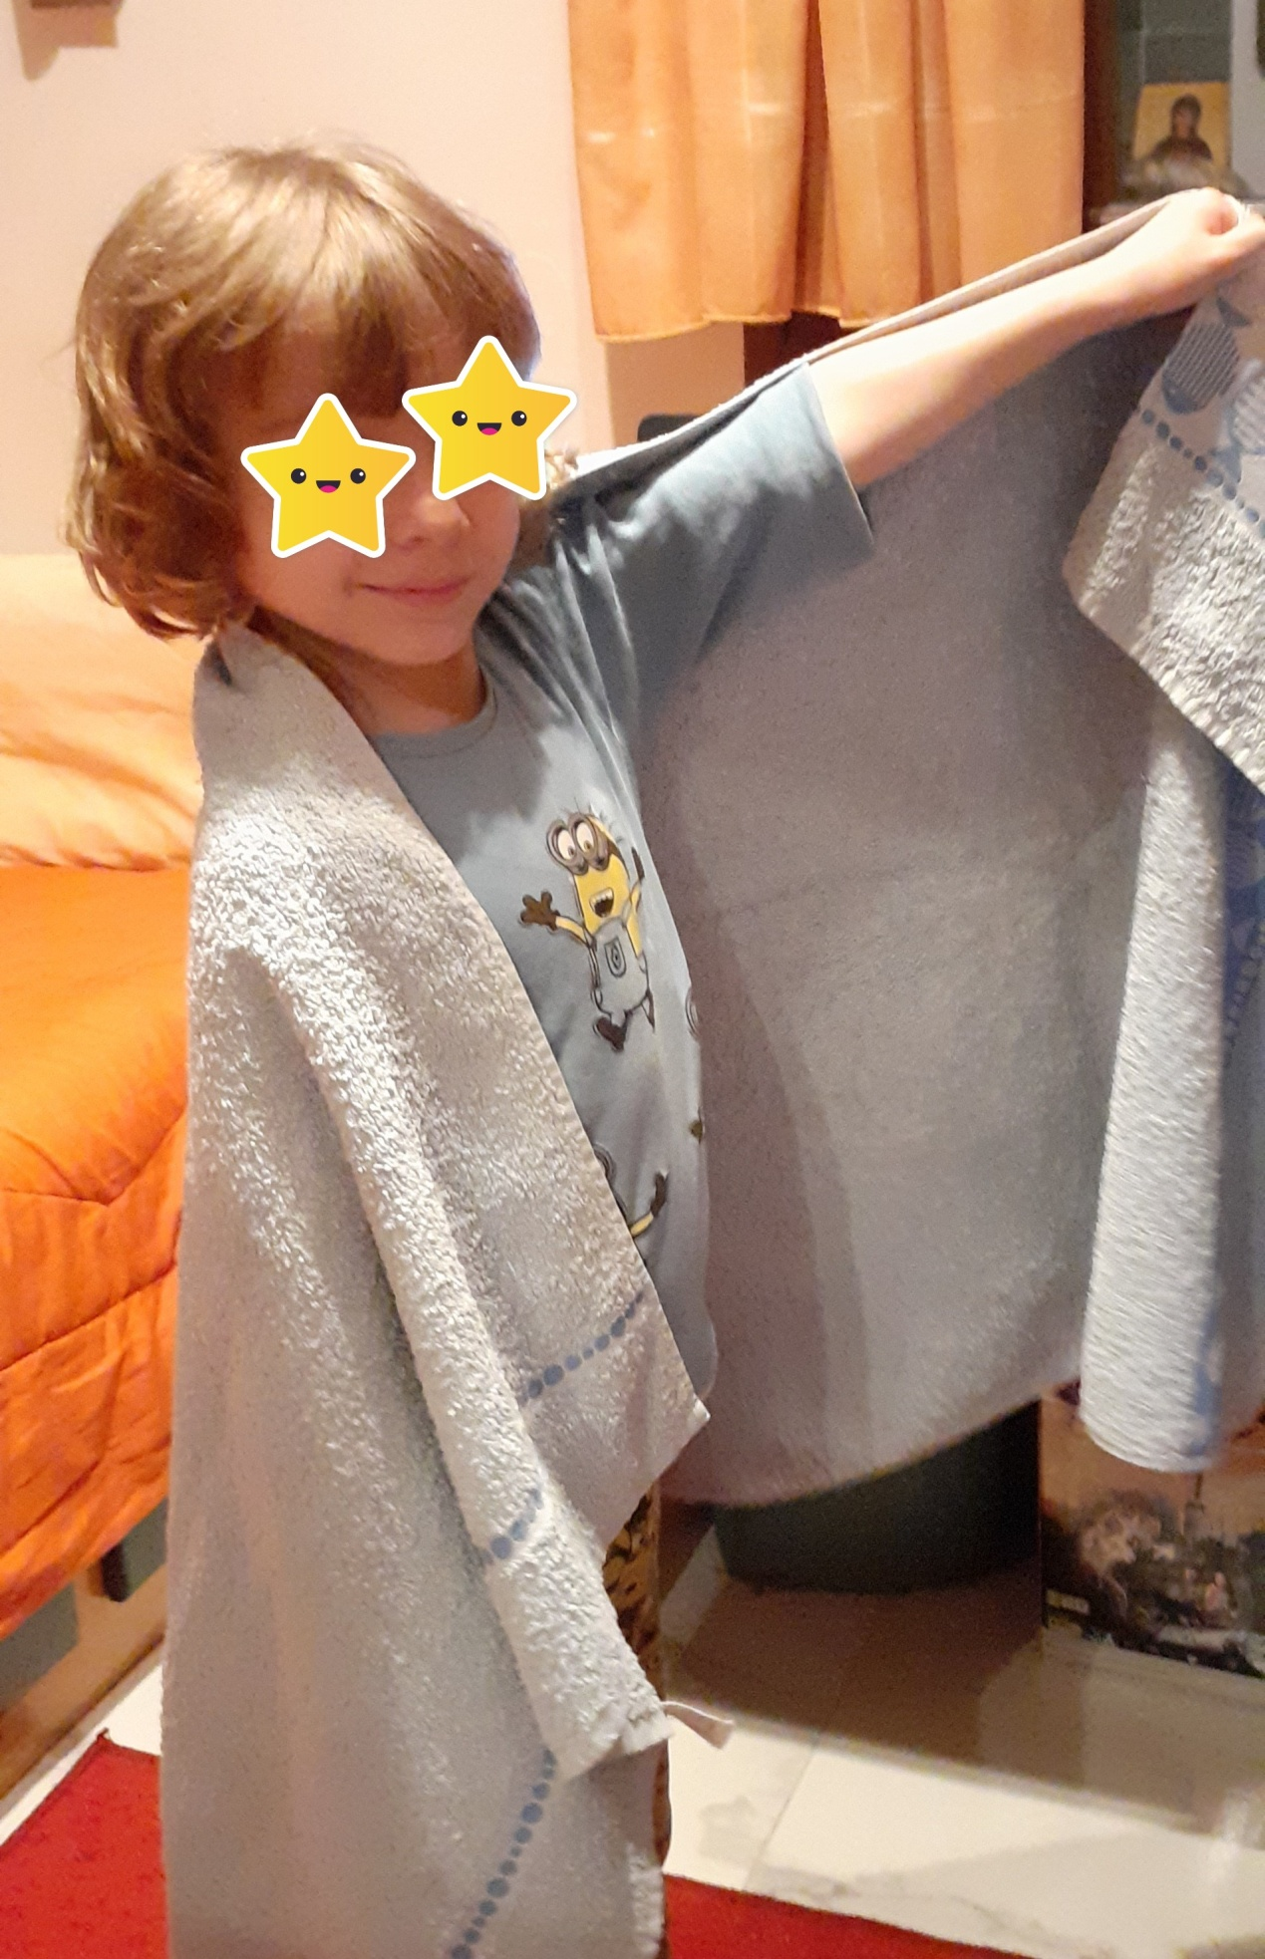
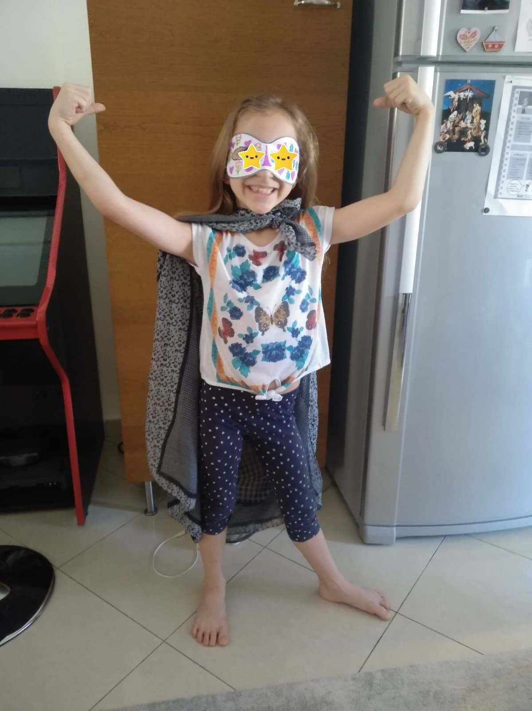
We have some
superpowers here!

Slide 23
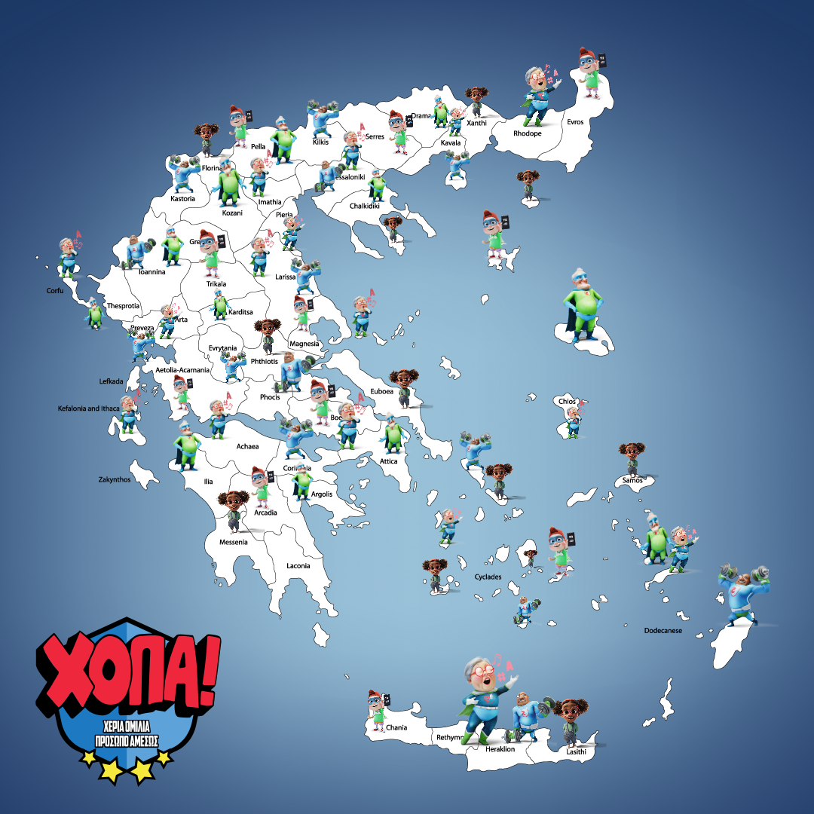
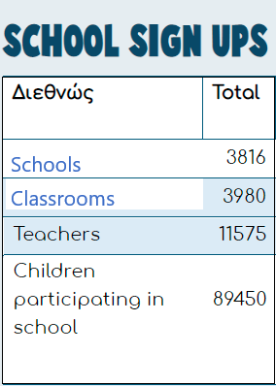
The “Fast Heroes 112” campaign has spread
all over Greece and the rest of the world and it
continuous with more than 3816 schools up until
now !!!

Slide 24
The experience of my participation in the “Fast Heroes 112” campaign was a life lesson!
The idea that along with my recovery, I could positively impact the lives of children and the general mentality about stroke was the best reward for me!
“Rehabilitation and integration to Real Life after a stroke is a matter of power and empowerment through individual and community strategies”

