Slide 1

Communication in everyday life
1st European Life After Stroke Forum
12 March 2022
Jean-Marie Annoni , Alexia Kountouri , Mina Michalatou,
Jürg Schwyter, Hariklia Proios

Slide 2
Plan
The communicating brain
Communication Challenges
Communication Strategies

Slide 3
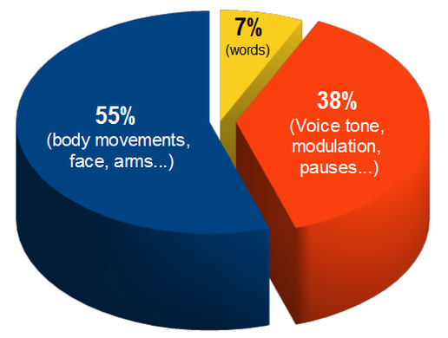
Language is (only) part of communication
Speak and communication

Slide 4
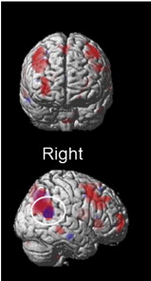
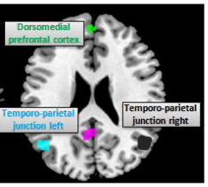
Speaking Brain
Words
Around the words
Social network
Price 2012
Hagoort 2013
Kobayashi 2014
Amft et al 2015

Slide 5
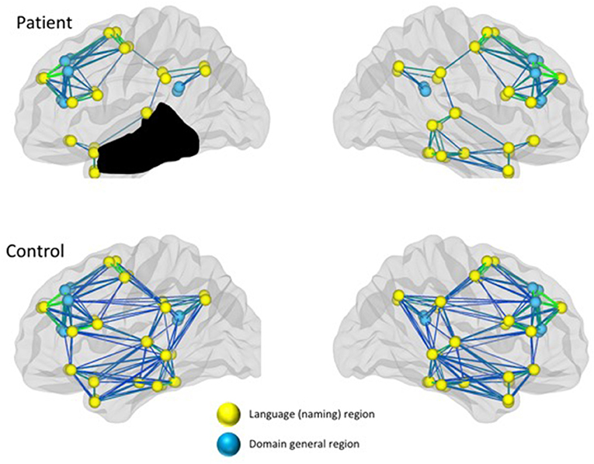
Brain rewires after stroke using his general domain area
Recovering Brain
Before aphasia
Language area
General area
After aphasia
After Kiran & Thompson 2019

Slide 6
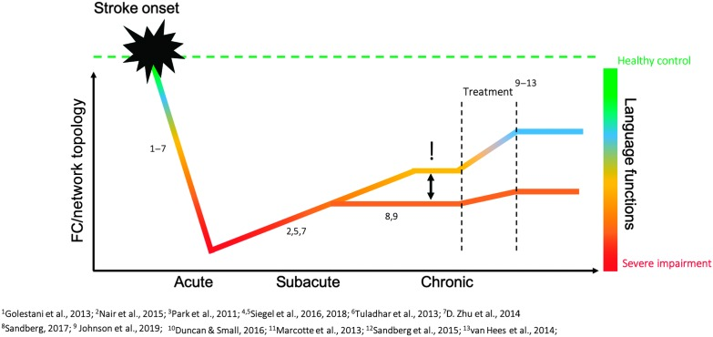
Recovering brain and communication
functional connectivity (FC)

Slide 7
Example of challenges : math in everyday life
Some people with aphasia may have difficulty with everyday life math tasks even if they can do algebra!
Time
(e.g. Punctuality for appointments)
Measure
(e.g. Administer drug calculate spaghetti)
Money
(e.g. Shopping, change, bank)
Transportation
(e.g. Correct bus )
Communication
(e.g. telephone, choose TV channels)
References:
Proios, Tsakpounidou, Karapanayiotides, Priftis, & Semenza. (2021). Journal of the International Neuropsychological Society, 1-13.
Semenza, Meneghello, Arcara, Burgio, Gnoato … Butterworth. (2014). Frontiers in Aging Neuroscience, 6, 112.
Toffano, Burgio, Palmer, Benavides-Varela, Meneghello … Semenza, (2021). Neurological sciences,42(10), 4183–4191.

Slide 8
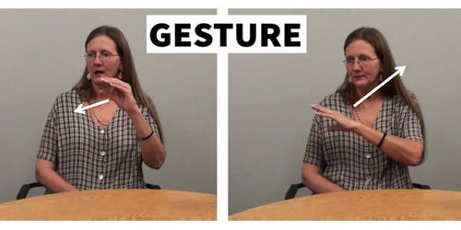
Strategies of communication after aphasia
Spoken language is the mode of choice for communication
Finding the correct syllables is related to measures of functional communication
non-verbal cognition can solve a communicative task
Focus also training of non-verbal cognition
Schumacher et al, Brain Comm, 2020,
C de Beer, 2017

Slide 9
Communication strategies
activity-oriented therapy approach (Bruce 2019)
2. Nontraditional approach to talk
  use mobile phone photos to create stories;
  virtual technologies .
  Professional expertise and familiar topics (haley 2019 )
3. increased collaboration with speech-language pathologists
Strong et al , 2022, Hansen et al 2017

Slide 10
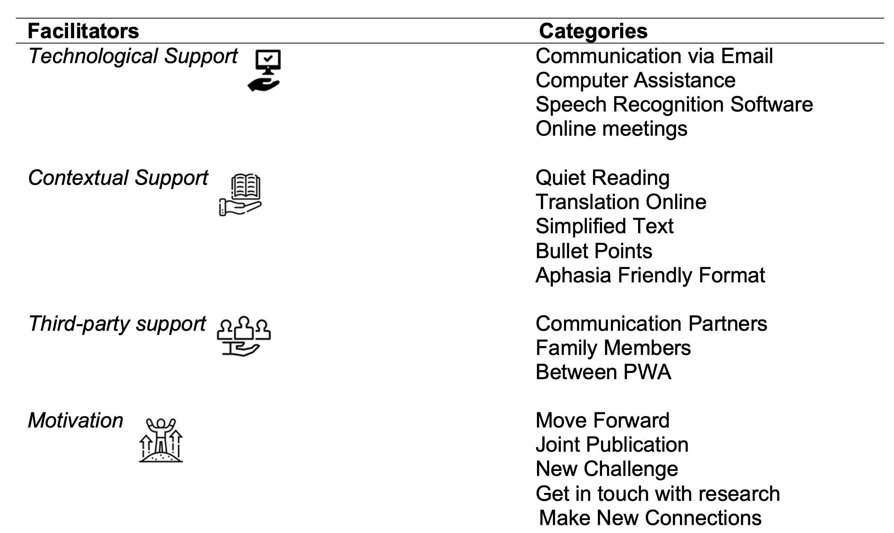
Facilitator : analysis of researchers + people with aphasia group
Charalambous, in reviewing

Slide 11
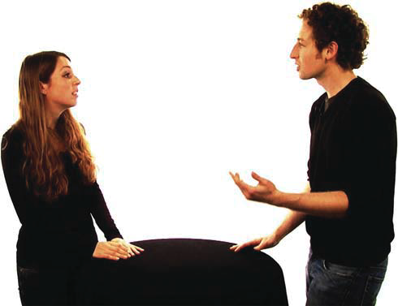
Challenges in non verbal strategy
Person with aphasia tend to fixate less the speaker's face
B Preisig , N Eggenberger , G Zito , T Vanbellingen , R Schumacher, S Hopfner , T Nyffeler, K Gutbrod , JM Annoni , S Bohlhalter RM. Muri 2015

Slide 12

Reflexions of 3 experts with aphasia

Slide 13
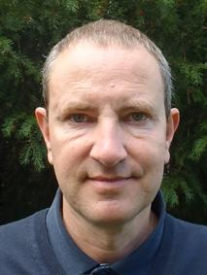
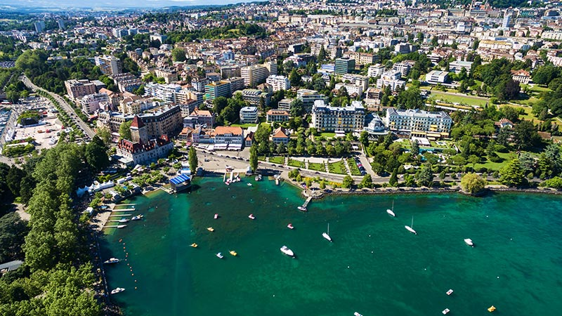
Jürg Rainer Schwyter, Linguist
Switzerland

Slide 14

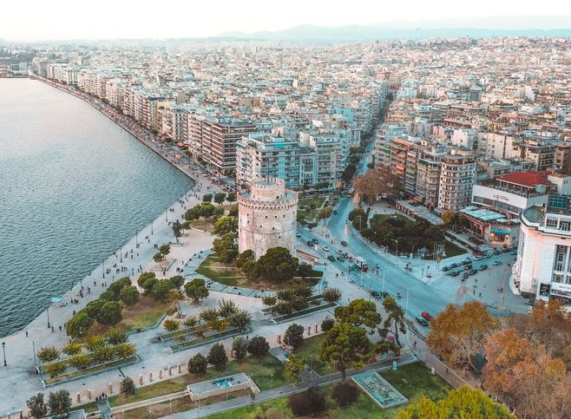
Mina Michalatou, Archaeologist,
Thessaloníki, Greece

Slide 15
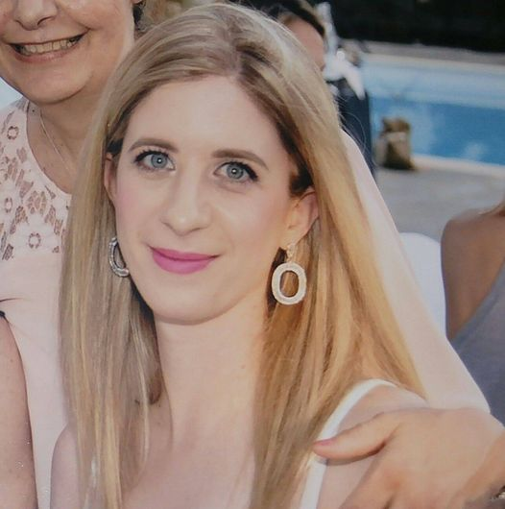
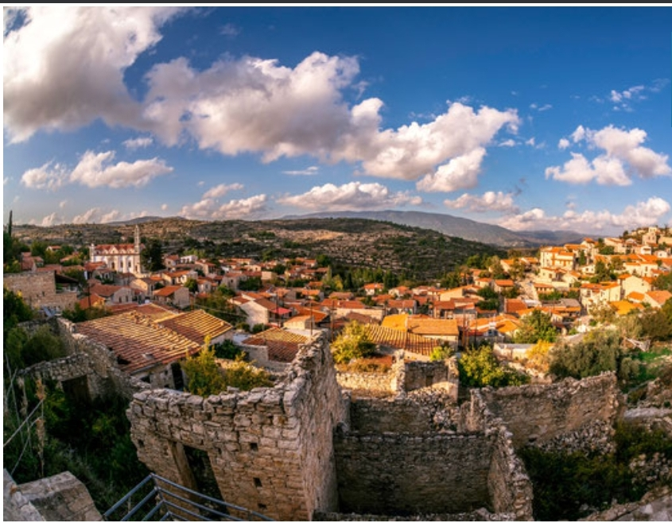
Alexia Kountouri, Social worker
Nicosia, Cyprus stroke association

Slide 16
thanks

