Slide 1
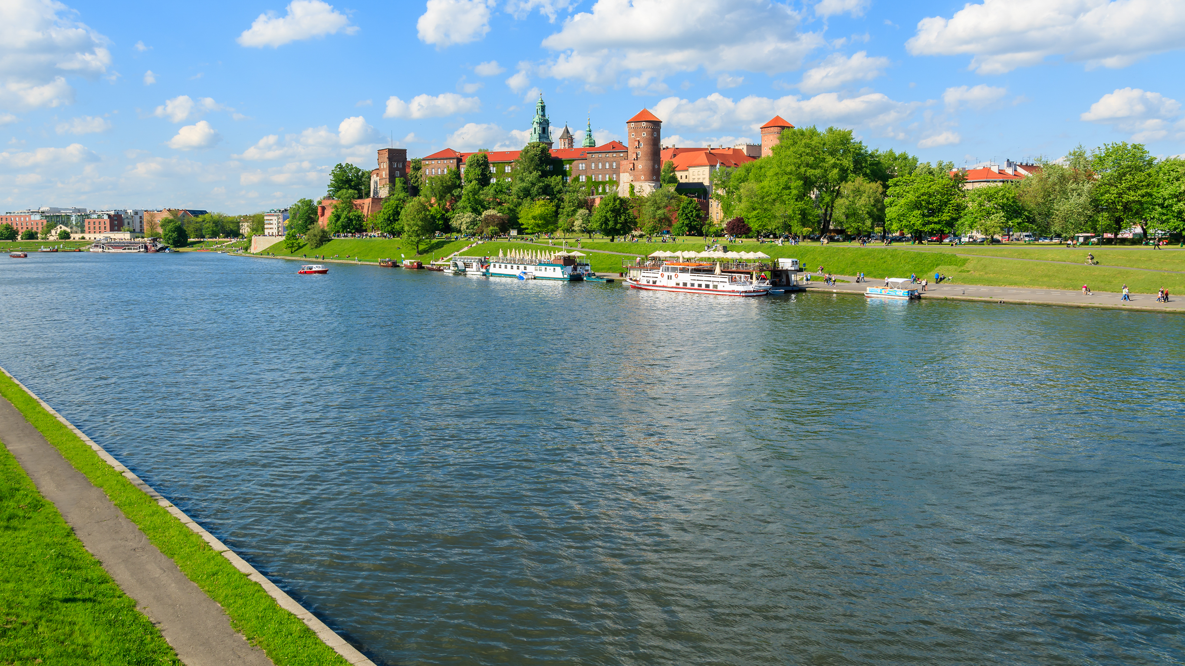



KRAKÓW
ABSTRACT SUBMISSIONS NOW OPEN
SCAN QR CODE
to subscribe to our newsletter
For anyone with an interest in life after stroke
– latest research, best practice and shared insights
Stroke survivors, caregivers, healthcare professionals, researchers and advocates
Hosted by
#lifeafterstroke

